Slide 1
life of a Native American
By: Abby, Julia, Jeff, David

Slide 2
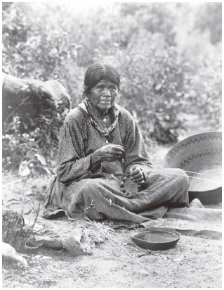
Women
Women were an important part of the daily life of Native Americans. They were more than just mothers, They were builders, warriors, farmers, and craftswomen. The strength of the women was essential to the survival of the tribes. the women were in charge of gathering materials and then building the homes for everyone. women in Native American tribes often helped their men hunt buffalo. the women skinned, cut, and cooked the animal. They also gathered firewood, cooked, and repaired clothing and shoes.

Slide 3
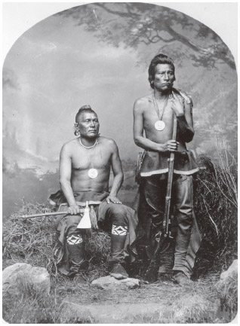
Men
Similar to other societies men were the leaders of the household. Men hunted, fought in battle, negotiated treaties and agreements, and made decisions about moving. Men were chiefs, medicine men, and priests, though women could also take on these roles at times. Men cut down trees to clear land for planting. They used the wood to build canoes, homes, and the pole fences around the villages. They made traps, nets, and other tools. They fixed moccasins.

Slide 4
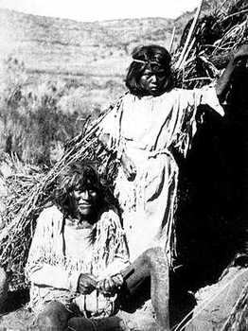
Children
The Native American children were taught by their elders. They were taught how to do errands, be warriors, to cook, to hunt, to take care of kids.in each tribe there were different roles for both boys and girls. As the kids grew up they helped their parents. The boys went with the men and the girls went with the women. They watched their parents work and learned from them.

Slide 5
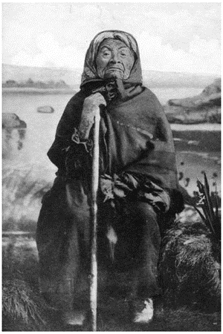
Grandparents
The grandparents are responsible for raising and educating children. The grandparents teach the children that cultural knowledge, spiritual awareness, and kinship ties are continued for generations. Grandparents act as a cultural conservator. they eagerly request their children to have their grandchildren stay with them for an extended amount of time to expose them to the Native American way of life..

Slide 6
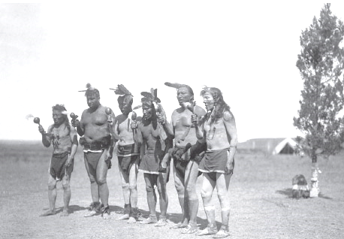
Tribes
There were many different Native American tribes and those with similar characteristics formed a main tribe or nation. Each had its own language, religion and customs. For the most part the tribes lived peaceably believing that nature was sacred and was to be shared. However, the coming of the Europeans and the removal of their land led to conflict both between the different tribes and between the Indians and whites.

